Slide 1
SENTENCE SIMILARITY
b.mohanapriya, pga25
Imarticus, chennai

Slide 2
CONTENT
INTRODUCTION
PROBLEM STATEMENT
WORK FLOW
ALGORITHM IMPLEMENTATION
EXPERIMRNTAL SETUPS
VALIDATION
RESULTS
CONCLUSION

Slide 3
Problem statement
To develop a model that can accurately identify duplicate questions from the Quora dataset, and help improve the user experience by providing relevant and diverse content to the Quora community while reducing redundancy.

Slide 4
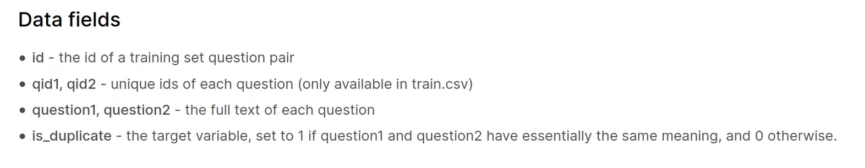

Slide 5
There are common words in both sentences but different in meaning
What can I do to practice my English? | How can I learn to speak a fluent English?
Did Trump win the election? | What do you think of Trump winning the elections?
Can skipping increase your height? | How do I increase the height

Slide 6
Two types of sentences with same meaning
What can I do to practice my English? | How can I continue to improve my English?
Which are the best movies of 2016? | Which was the best film of 2016?
Why do dogs wag their tails when they are happy? | Why do dogs wag their tails?

Slide 7
Overall solution approach
Pre-processing
Identifying duplicate questions
Tokenisation
Creating vectors
Distance measures
Creating new dataframe based on distance measures
Model building

Slide 8
Some of the popular similarity measures are
Euclidean Distance.
Manhattan Distance.
Jaccard Similarity.
Minkowski Distance.
Cosine Similarity.

Slide 9
Fuzzy matching is a technique used to match strings that are not exact matches.
fuzz.ratio(): compares two strings based on the ratio of their shared characters to their total characters.
fuzz.partial_ratio(): compares two strings based on the ratio of their shared characters to the length of the shorter string.
fuzz.token_sort_ratio(): compares two strings based on the ratio of their shared words, after sorting the words in each string alphabetically.
fuzz.token_set_ratio(): compares two strings based on the ratio of their shared words, after removing any duplicates.

Slide 10
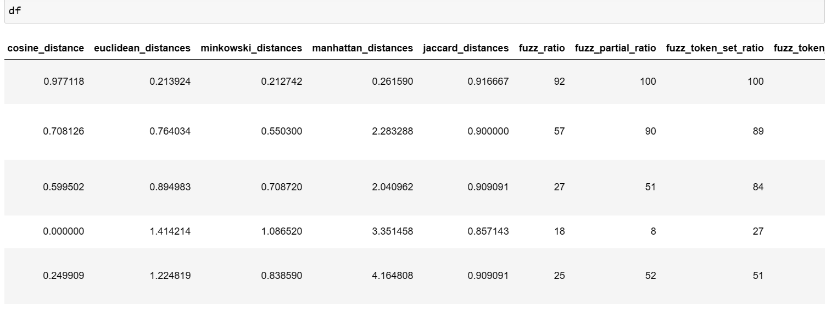

Slide 11
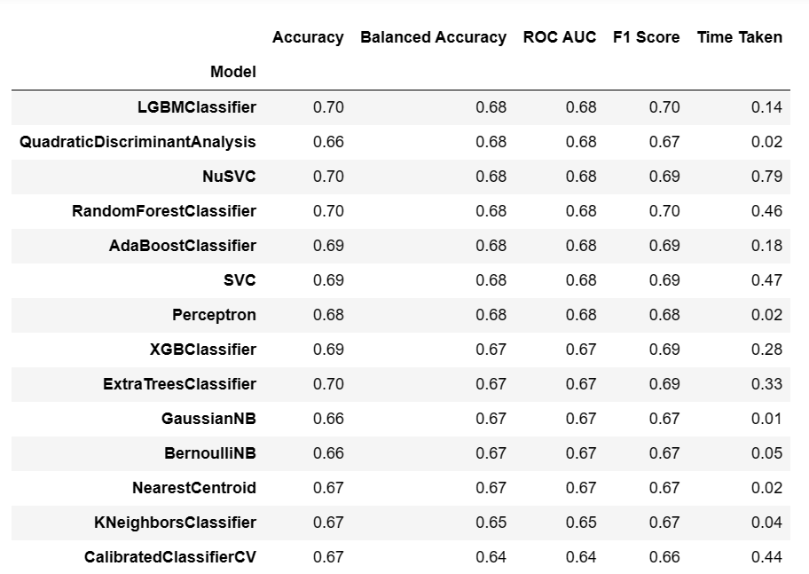

Slide 12
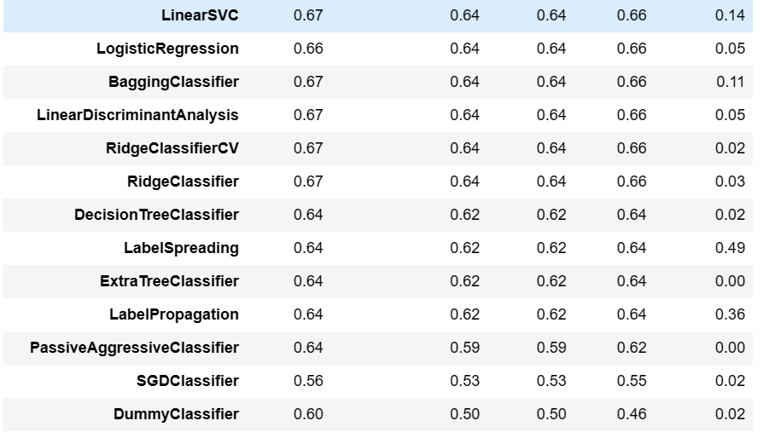

Slide 13
Key findings
The dataset is imbalanced
Similarity metrics are useful: Metrics such as cosine similarity and Jaccard similarity are effective for identifying similar question pairs. However, they may not be as effective for identifying exact duplicates or semantically similar questions.
BOOSTING models can be effective

Slide 14
Further improvement areas of this project
Trying to build bert transformer model on quora dataset.
My work is in process.

Slide 15
Thank you

